Slide 1
Unit 6 Basic I/O, Memory R/W and Interrupt Operations

Slide 2
Contents:
1. Memory read/write, input/output, read/write operation in 8085 microprocessor based system
2. Direct memory access (DMA) Introduction, advantage and application DMA controller 8237 interfacing
3. Interrupt 8085 interrupt pins and interrupt priority Maskable and non-maskable interrupts Vector and polled interrupt
4. 8259 operation Block diagram and explanation Priority modes and other features

Slide 3
Memory
Primary
R/W
Read only
Secondary
Semi random access
Serial access
Dynamic RAM
Static RAM
EPROM
EEPROM
FLASH
Masked ROM
PROM
Disks
Floppy
HDD
CDROM
DVD
Magnetic Tape
CCd(Charged Coupled Device)

Slide 4
1. Primary Memory
It is the memory used by microprocessor to execute programs.
The microprocessor can access only those items that are stored in this memory.
Hence, all data and program must be within primary memory prior to its execution.
Primary memory is much larger than processer memory that is included in the microprocessor chip.

Slide 5
a. R/W Memory (RAM )
Microprocessor can read for and write into this memory .
This memory is used for information that are likely to be altered such as writing program or receiving data.
This memory is volatile i.e. the content will be lost if the power is turned off and commonly known as RAM, RAM are basically of two types.

Slide 6
A. Static RAM (SRAM)
This memory is made up of flip flops and it stores bit as voltage.
A single flip flop stores binary data either 1 or 0.
Each flip flop is called storage cell.
Each cell requires six transistors.
Therefore, the memory chip has low density but high speed.
This memory is more expensive and consumes more power.
B. Dynamic RAM (DRAM)
This memory is made up of MOS transistor gates and it stores the bit as charge.
The advantage of DRAM are it has high density, low power consumption and cheaper than SRAM.
But the bit information leaks therefore needs to be rewritten again every few milliseconds.
It is called refreshing the memory and requires extra circuitry to do this.
It is slower than SRAM.

Slide 7
b. Read Only Memory (ROM):
ROM contains a permanent pattern of data that cannot be changed. It is non volatile that is no power source is required to maintain the bit values in memory. ROM are basically of 5 types.
A. Masked ROM: A bit pattern is permanently recorded by the manufactures during production.
B. Programmable ROM: In this ROM, a bit pattern may be written into only once and the writing process is performed electrically. That may be performed by a supplier or customer.

Slide 8
C. Erasable PROM (EPROM): This memory stores a bit in the form of charge by using EPROM programmer which applies high voltage to charge the gate .Information can be erased by exposing ultraviolet radiation. It is reusable. The disadvantages are :(i) it must be taken out off circuit to erase it (ii). The entire chip must be erased (iii) the erasing process takes 15 to 20 minutes.
D. Electrically Erasable PROM(EEPROM): It is functionally same as EPROM except that information can be altered by using electrical signal at the register level rather than erasing all the information. It is expensive compared to EPROM and flash and can be erased in 10ms.
E. Flash Memory: It is variation of EPROM. The difference is that EPROM can be erased in register level but flash memory must be erased in register level but flash memory must be erased in its entirety or at block level

Slide 9
2. Secondary memory
The devices that provide backup storage are called secondary memory. It includes serial access type such as magnetic disks and random access type such as magnetic disks. It is nonvolatile memory.

Slide 10
Performance of memory:
1. Access time (ta):
Read access time: It is the average time required to read the unit of information from memory.
Write access time: It is the average time required to write the unit of information on memory.
Access rate (ra) = 1/ta
2. Cycle time (tc):
It is the average time that lapses between two successive read operation .
Cycle rate (rc)= bandwidth = 1/tc

Slide 11
Access modes of memory:
1. Random access: In random access mode, the ta is independent of the location from which the data is accessed.
2. Sequential access: In that mode, the ta is dependent of the location form which the data is accessed.
3. Semi random-access: the semi random access combines these two. For eg. In magnetic disk, any track can be accessed at random. But the access within the truck must be in serial fashion.

Slide 12
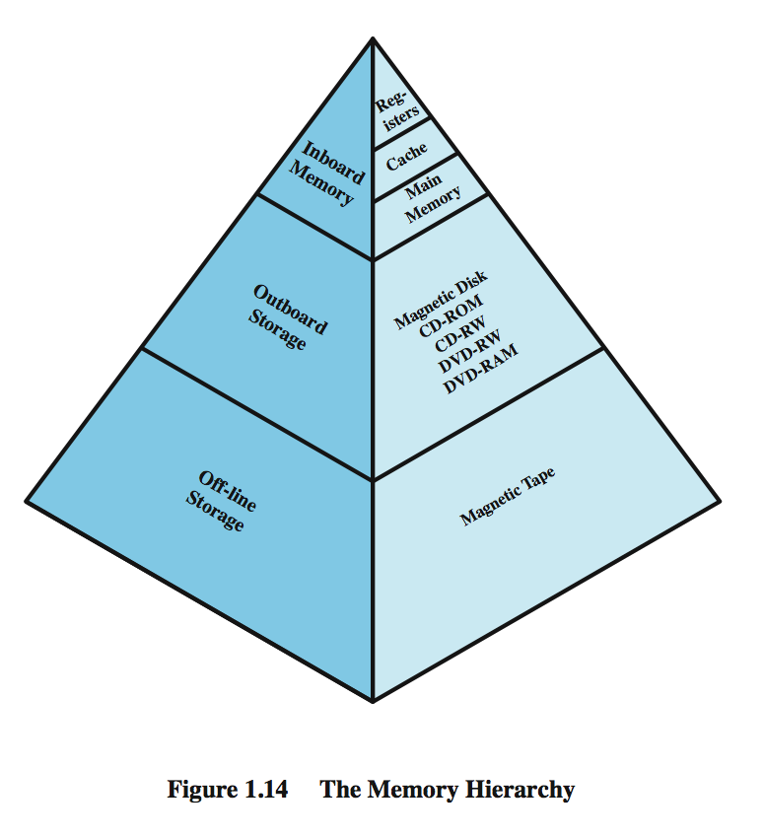
Speed Memory size
Cost (per bit)
Access Time i.e. Slower
Capacity

Slide 13
Address decoding:
Microprocessor is connected with memory and I/O devices via common address and data bus.
Only one device can send data at a time and other devices can only receive that data.
If more than one device sends data at the same time, the data gets garbled.
In order to avoid this situation, ensuring that the proper device gets addressed at proper time, the technique called address decoding is used.

Slide 14
In address decoding method, all devices like memory blocks, I/O units etc. are assigned with a specific address.
The address of the device is determined from the way in which the address lines are used to derive a special device selection signal known as chip select (CS).
If the microprocessor has to write or to read from a device, the CS signal to that block should be enabled and the address decoding circuit must ensure that CS signal to other devices are not activated.

Slide 15
Types of Address Decoding
A. Depending upon the no. of address lines used to generate chip select signal for the device, the address decoding is classified as:
1. I/O mapped I/O
In this method, a device is identified with an 8 bit address and operated by I/O related functions IN and OUT for that IO/M =1. Since only 8 bit address is used, at most 256 bytes can be identified uniquely. Generally low order address bits A₀-A₇ are used and upper bits A₈-A₁₅ are considered don’t care. Usually I/O mapped I/O is used to map devices like 8255A, 8251A etc.

Slide 16
2. Memory mapped I/O
In this method , a device is identified with 16 bit address and enabled memory related functions such as STA, LDA for which IO/M =0, here chip select signal of each device is derived from 16 bit address lines thus total addressing capability is 64K bytes. Usually memory mapped I/O is used to map memories like RAM, ROM etc.

Slide 17
B. Depending on the address that are allocated to the device, the address decoding are categorized in the following two groups.
1. Unique Address Decoding:
If all the address lines on that mapping mode are used for address decoding then that decoding is called unique address decoding. It means all 8-lines in I/O mapped I/O and all 16 lines in memory mapped I/O are used to derive signal. It is expensive and complicated.

Slide 18
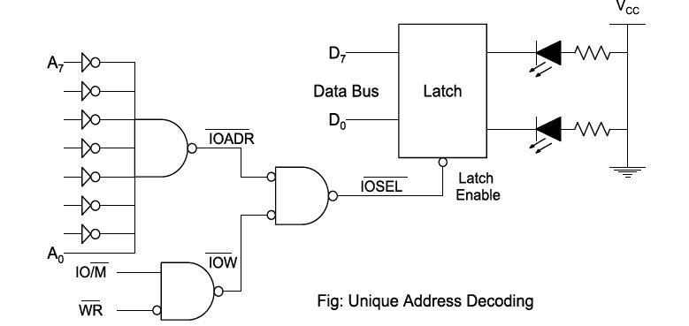
If A0 is high and A1- A7 are low and if IOW becomes low, the latch gets enabled.
The data to the LED can be transferred in only one case and hence the device has unique address of 01H.

Slide 19
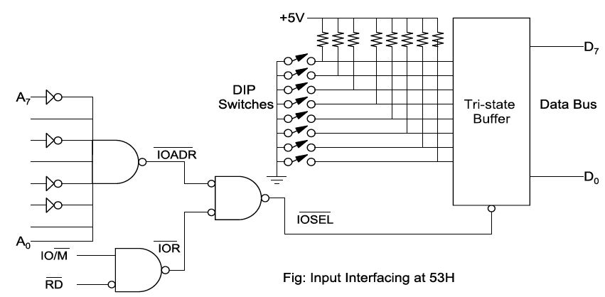
Eg: Eight I/P switch interfacing at 53H. (01010011)

Slide 20
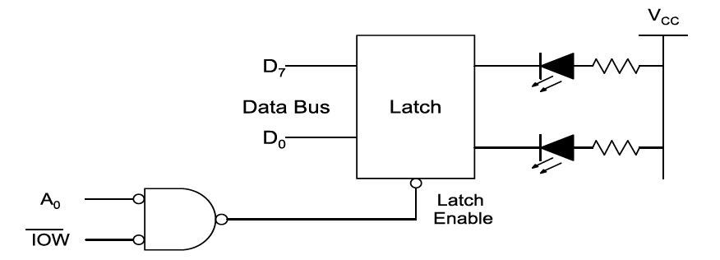
2. Non Unique Address decoding:
If all the address lines available on that mode are not used in address decoding then that decoding is called non unique address decoding.
If A0 is low. Then latch gets enabled.
Here A1-A7 is neglected that is any even address can enable the latch.

Slide 21
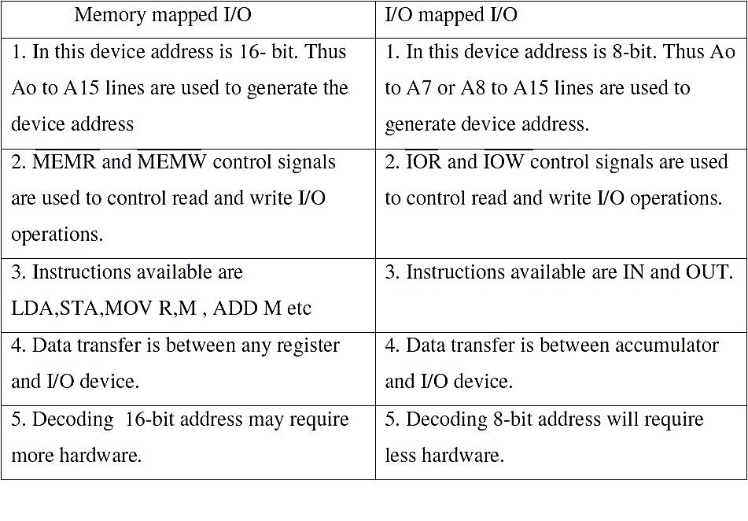

Slide 22
Direct Memory Access (DMA)
&
DMA Controllers

Slide 23
Direct Memory Access (DMA) & DMA Controllers
It is a feature of a modern computer systems that allows certain hardware subsystems to access main system memory(to read or write data to or from memory) without microprocessor intervention (independent of the central processing unit), allowing processor to do other work.
It means DMA is a method of transferring data from the computer's RAM to another part of the computer without processing it using (CPU).
Most data that is input or output from your computer is processed by the CPU, but some data does not require processing, or can be processed by another device. In these situations, DMA can save processing time and is a more efficient way to move data from the computer's memory to other devices.
For example, a sound card may need to access data stored in the computer's RAM, but since it can process the data itself, it may use DMA to bypass the CPU. Video cards that support DMA can also access the system memory and process graphics without needing the CPU.

Slide 24
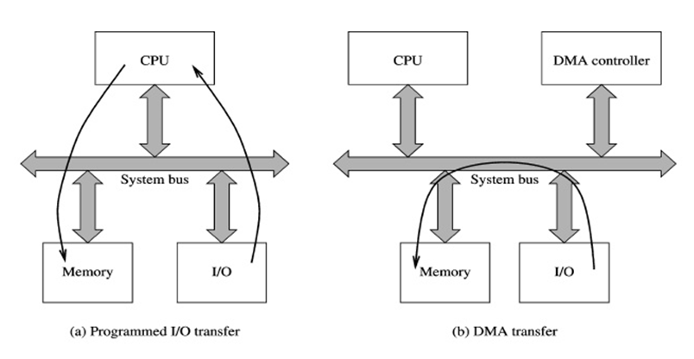

Slide 25
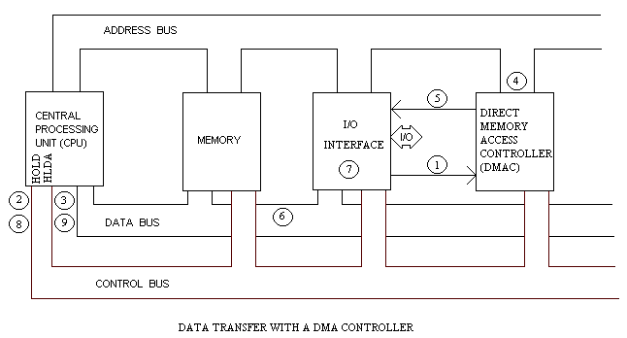
Basic DMA Operation

Slide 26
During a block input byte transfer, the following sequence occurs as the data byte is sent from the interface to the memory:
The interface sends the DMA controller a request for DMA service.
A Bus request is made to the HOLD pin (active High) on the processor and the controller gains control of the bus.
A Bus grant is returned to the DMA controller from the Hold Acknowledge (HLDA) pin (active High) on the processor.
The DMA controller places contents of the address register onto the address bus.
The controller sends the interface a DMA acknowledgment, which tells the interface to put data on the data bus.
The data byte is transferred to the memory location indicated by the address bus.
The interface latches the data.
The Bus request is dropped, the HOLD pin goes Low, and the controller relinquishes the bus.
The Bus grant from the processor is dropped and the HLDA pin goes Low.
The address register is incremented by 1.
The byte count is decremented by 1.
If the byte count is non-zero, return to step 1, otherwise stop.

Slide 27
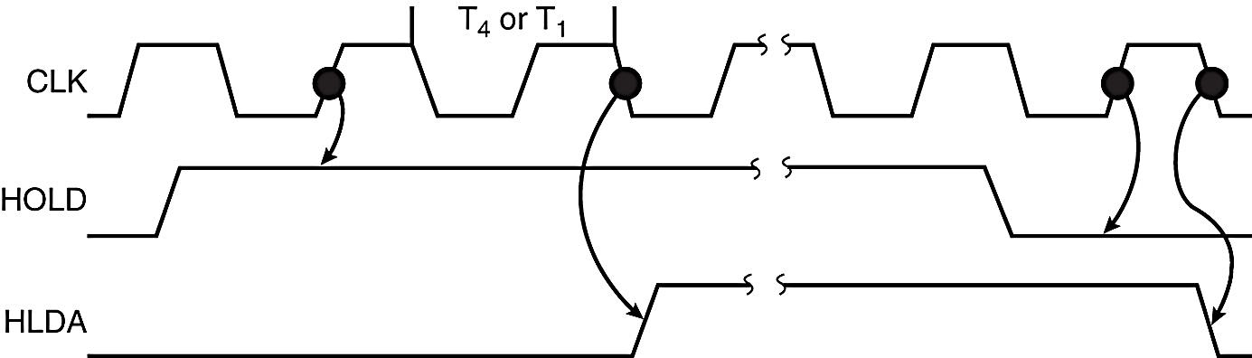
Timing diagram of DMA operation
HOLD is sampled in any clocking cycle.
When the processor recognizes the hold, it stops executing software and enters hold cycles.
HLDA becomes active to indicate the processor has placed its buses at high-impedance state.
as can be seen in the timing diagram, there are a few clock cycles between the time that HOLD changes and until HLDA changes
HLDA output is a signal to the requesting device that the processor has relinquished control of its memory and I/O space.

Slide 28
Direct Memory Access Controller (DMAC) options for data transfer
The DMA Controller has several options available for the transfer of data. They are:
1) Cycle Steal:
A read or write signal is generated by the DMAC, and the I/O device either generates or latches the data. The DMAC effectively steals cycles from the processor in order to transfer the byte, so single byte transfer is also known as cycle stealing.
2) Burst Transfer:
To achieve block transfers, some DMAC's incorporate an automatic sequencing of the value presented on the address bus. A register is used as a byte count, being decremented for each byte transfer, and upon the byte count reaching zero, the DMAC will release the bus. When the DMAC operates in burst mode, the CPU is halted for the duration of the data transfer.

Slide 29
3) Hidden DMA
It is possible to perform hidden DMA, which is transparent to the normal operation of the CPU. In other words, the bus is grabbed by the DMAC when the processor is not using it. The DMAC monitors the execution of the processor, and when it recognizes the processor executing an instruction which has sufficient empty clock cycles to perform a byte transfer, it waits till the processor is decoding the op-code, then grabs the bus during this time. The processor is not slowed down, but continues processing normally. Naturally, the data transfer by the DMAC must be completed before the processor starts.

Slide 30
Advantages of DMA
Computer System performance is improved by direct transfer of data between memory and I/O devices bypassing the processor
Processor is free to perform operation that donot use system buses.
Quick data transfer.
Disadvantages of DMA
In case of Burst mode of transfer, the processor is rendered inactive for longer period of time.
Application of DMA
Extensively used for computer-based data acquisition including streaming data to disk, real-time screen data display and continuous data acquisition.
DMA is used in HDD in later version.
PC-based DMA technology, along with high-speed bus technology, is driven by data storage, communications and graphics needs-all of which require the highest rates of data transfer between system memory and I/O devices.
Data acquisition applications have the same needs and therefore can take advantage of the technology developed for larger markets.

Slide 31
8237 DMA Controller
and
Interfacing

Slide 32
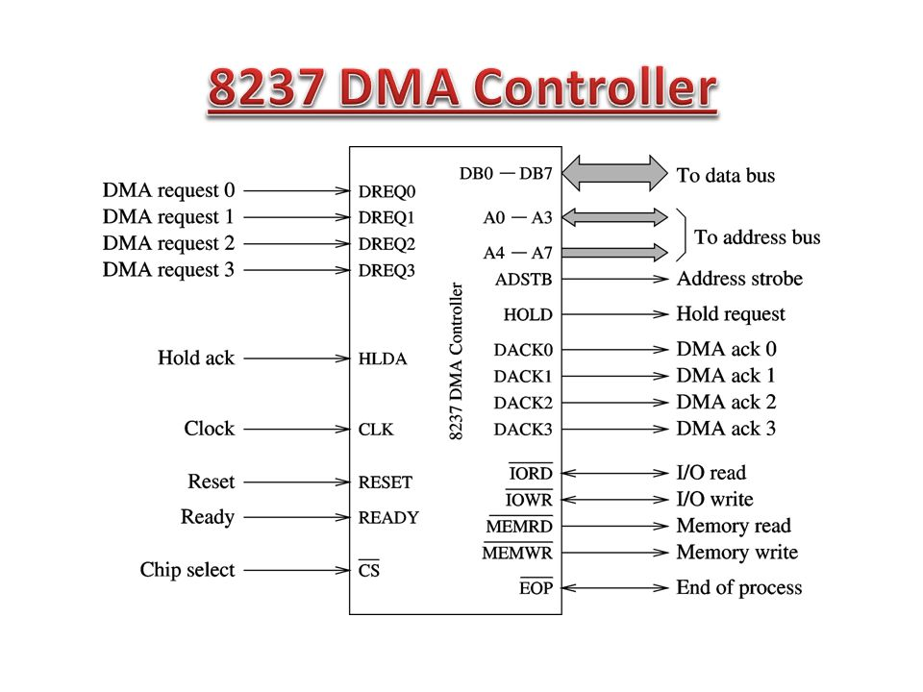
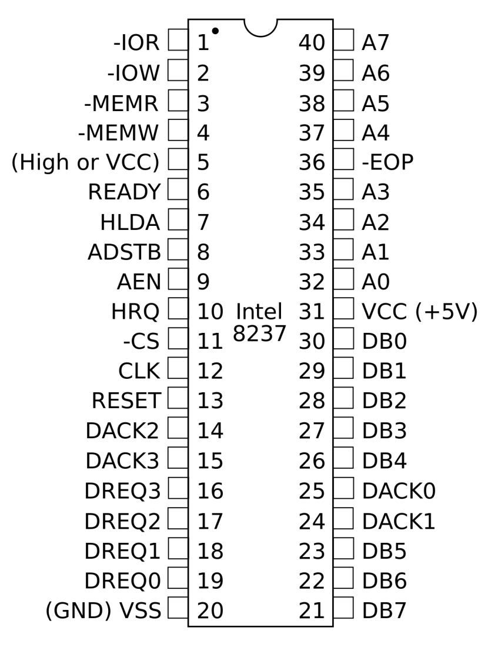

Slide 33
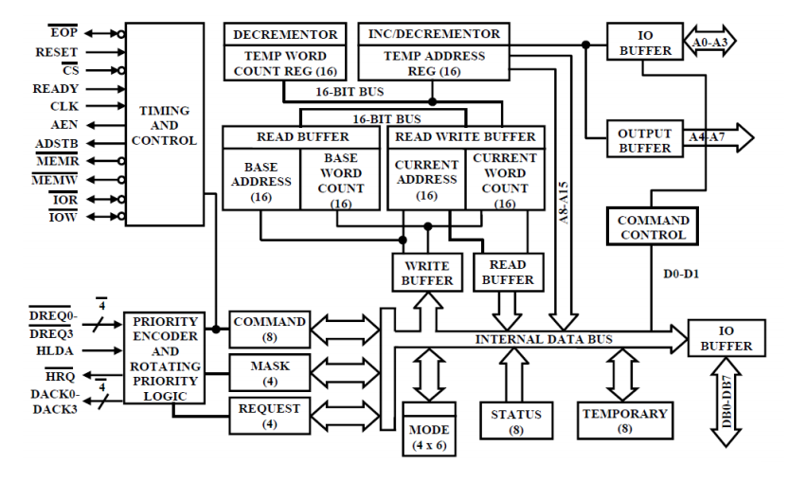
Fig: Block Diagram of 8237 DMA Controller

Slide 34
Interrupt-Operations

Slide 35
Interrupt
Interrupt is signals send by an external device to the processor, to request the processor to perform a particular task or work.
Mainly in the microprocessor based system the interrupts are used for data transfer between the peripheral and the microprocessor.
Need for Interrupt: Interrupts are particularly useful when interfacing I/O devices that provide or require data at relatively low data transfer rate.

Slide 36
Polling vs. Interrupt
Polling the device usually means reading its status register every so often until the device's status changes to indicate that it has completed the request.
Polling means the CPU keeps checking a flag to indicate if something happens.
An interrupt driven device driver is one where the hardware device being controlled will cause a hardware interrupt to occur whenever it needs to be serviced.
With interrupt, CPU is free to do other things, and when something happens, an interrupt is generated to notify the CPU. So it means the CPU does not need to check the flag.
Polling is like picking up your phone every few seconds to see if you have a call. Interrupts are like waiting for the phone to ring.
Interrupts win if processor has other work to do and event response time is not critical.

Slide 37
Interrupt Operations
The interrupt driven I/O operation takes the following steps.
The I/O unit issues an interrupt signal to the processor for exchange of data between them.
The processor finishes execution of the current instruction before responding to the interrupt.
The processor sends an acknowledgement signal to the device that it issued the interrupt.
The processor transfers its control to the requested routine called “Interrupt Service Routine (ISR)” by saving the contents of program status word (PSW) and program counter (PC).
The processor now loads the PC with the location of interrupt service routine and then fetches the instructions. The result is transferred to the interrupt handler program.
When interrupt processing is completed, the saved register’s value are retrieved from the stack and restored to the register.
Finally it restores the PSW and PC values from the stack.

Slide 38
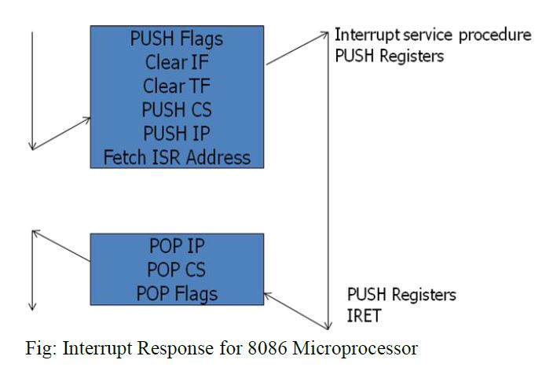
The figure summarizes these steps.
The processor pushes the flag register on the stack, disables the INTR input and does essentially an indirect call to the interrupt service procedure.
An IRET function at the end of interrupt service procedure returns execution to the main program.

Slide 39
Interrupt Service Routine
An interrupt service routine (ISR) is a software routine that hardware invokes in response to an interrupt.
ISRs examine an interrupt and determine how to handle it.
ISR is responsible for doing the following things:
1. Saving the processor context
2. Acknowledging the interrupt
3. Restoring the processor context

Slide 40
Interrupt Vector
An interrupt vector is a pointer to where the ISR is stored in memory.
All interrupts (vectored or otherwise) are mapped onto a memory area called the Interrupt Vector Table (IVT).
The purpose of the IVT is to hold the vectors that redirect the microprocessor to the right place when an interrupt arrives.

Slide 41
Interrupt structures:
There are mainly two ways of servicing multiple interrupts
Polled interrupts
Daisy chain (vectored) interrupts.

Slide 42
Polled interrupts
Polled interrupts are handled by using software which is slower than hardware (vectored) interrupts.
Here the processor has the general (common) interrupt service routine (ISR) for all devices.
The priority of the devices is determined by the order in which the routine polls each device.
The processor checks the starting with the highest priority device.
Once it determines the source of the interrupt, it branches to the service routine for that device.

Slide 43
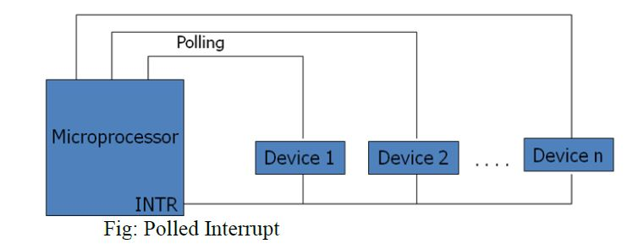
Here several external devices are connected to a single interrupt line (INTR) of the microprocessor.
When INTR signal goes up, the processor saves the contents of PC and other registers and then branches to an address defined by the manufactures of the processor.
The user can write a program at this address to find the source of the interrupt by starting the polled from highest priority device.

Slide 44
Daisy chain (vectored) interrupt
In polled interrupt, the time required to poll each device may exceed the time to service the device through software.
To improve this, the faster mechanism called vectored or daisy chain interrupt is used.
Here the devices are connected in chain fashion.
When INTR pin goes up, the processor saves its current status and then generates INTA signal to the highest priority device.
If this device has generated the interrupt, it will accept the INTA; otherwise it will push INTA to the next priority device until the INTA is accepted by the interrupting device.

Slide 45
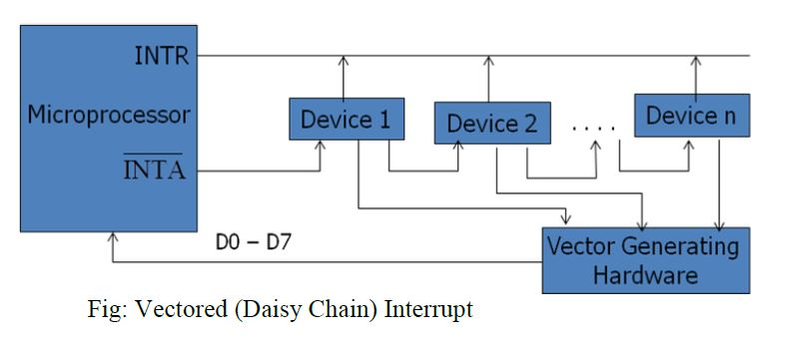
When INTA is accepted, the device provides a means to the processor for findings the interrupt address vector using external hardware.
The accepted device responds by placing a word on the data lines which becomes the vector address with the help of any hardware through which the processor points to appropriate device service routine.
Here no general interrupt service routine need first that means appropriate ISR of the device will be called.

Slide 46
Interrupt priority:
If the processor gets multiple interrupts, then we need to deal these interrupts one at a time and the dealing approaches are:
a. Sequential processing of interrupts
When user program is executing and an interrupt occurs, interrupts are disabled immediately.
After the interrupt service routine completes, interrupts are enabled before resuming the user program and the processor checks to see if additional interrupts have occurred.

Slide 47
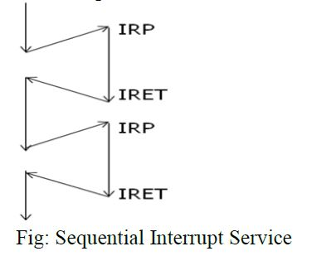

Slide 48
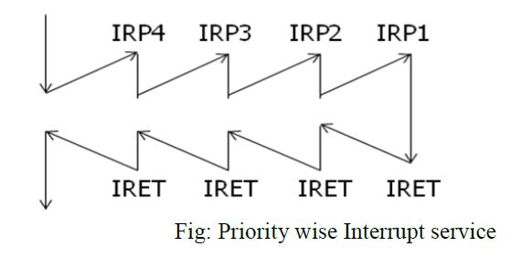
b. Priority wise processing of interrupts:

Slide 49
Types of interrupt
1. External interrupts:
These interrupts are initiated by external devices such as A/D converters and classified on following types.
a. Maskable interrupt :
It can be enabled or disabled by executing instructions such as EI and DI. In 8085, EI sets the interrupt enable flip flop and enables the interrupt process. DI resets the interrupt enable flip flop and disables the interrupt.
b. Non-maskable interrupt:
It has higher priority over maskable interrupt and cannot be enabled or disabled by the instructions.

Slide 50
2. Internal interrupts:
These are indicated internally by exceptional conditions such as overflow, divide by zero, and execution of illegal op-code. The user usually writes a service routine to take correction measures and to provide an indication in order to inform the user that exceptional condition has occurred.
These can also be activated by execution of TRAP instruction. This interrupt means TRAP is useful for operating the microprocessor in single step mode and hence important in debugging.
These interrupts are used by using software to call the function of an operating system. Software interrupts are shorter than subroutine calls and they do not need the calling program to know the operating system’s address in memory.

Slide 51
Interrupt Processing in 8085
Types of Interrupts:
1. Software interrupts:
The software interrupts are program instructions. These instructions are inserted at desired locations in a program.
The 8085 has eight software interrupts from RST 0 to RST 7. The vector address for these interrupts can be calculated as follows.
Interrupt number * 8 = vector address
For RST 5; 5 * 8 = 40 = 28H
Vector address for interrupt RST 5 is 0028H

Slide 52
Restart (RST) instruction
Interrupt | Vector address
RST 0 | 0000H
RST 1 | 0008H
RST 2 | 0010H
RST 3 | 0018H
RST 4 | 0020H
RST 5 | 0028H
RST 6 | 0030H
RST 7 | 0038H

Slide 53
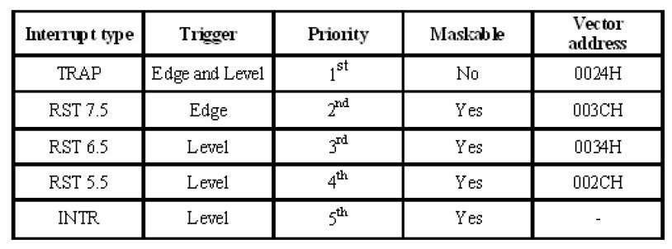
2. Hardware interrupts
An external device initiates the hardware interrupts and placing an appropriate signal at the interrupt pin of the processor.
If the interrupt is accepted then the processor executes an interrupt service routine.
The 8085 has five hardware interrupts

Slide 54
Programmable Interrupt Controller (PIC) -8259A
8259 is Programmable Interrupt Controller (PIC)
It is a tool for managing the interrupt requests.
8259 is a very flexible peripheral controller chip:
PIC can deal with up to 64 interrupt inputs.
interrupts can be masked
various priority schemes can also be programmed.
Originally (in PC XT) it is available as a separate IC
Later the functionality of (two PICs) is in the motherboards chipset.
In some of the modern processors, the functionality of the PIC is built in.

Slide 55
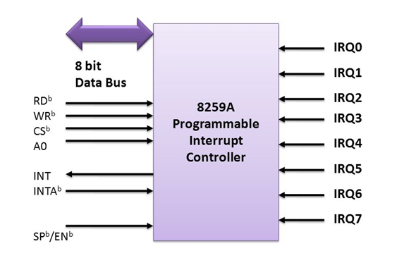

Slide 56
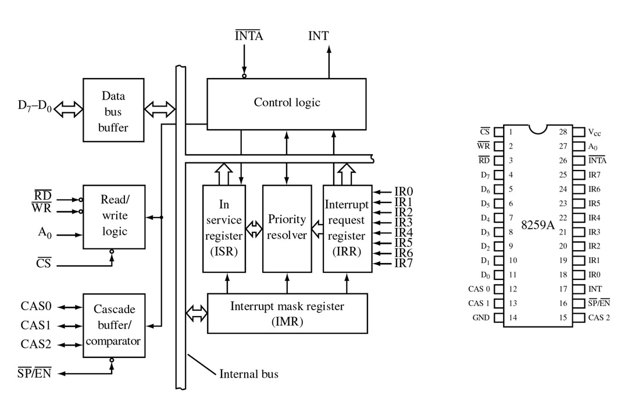

Slide 57
Operation:
The IRR stores the requests.
2. The priority resolver checks three registers: the IRR for interrupt requests, the IMR for masking bits, and the ISR for the interrupt request being served. It resolves the priority and sets the INT high when appropriate.
3. The MPU acknowledges the interrupt by sending INTA.
4. After the INTA is received, the appropriate priority bit in the ISR is set to indicate which interrupt level is being served, and the corresponding bit in the IRR is reset to indicate that the request is accepted. Then, the op-code for the CALL instruction is placed on the data bus.
5. When the MPU decodes the CALL instruction, it places two or more INTA signals on the data bus.

Slide 58
6. When 8259A receives the second INTA, it places the low-order byte of the CALL address on the data bus. At the third INTA, it places the high-order byte on the data bus. The CALL address is the vector memory location for the interrupt: this address is placed in the control register during the initialization.
7. During the third INTA pulse, the ISR bit is reset either automatically (Automatic-End-of-Interrupt-AEOI) or by a command word that must be issued at the end of the service routine (End-of-Interrupt-EOI). This option is determined by the initialization command word (ICW).
8. The program sequence is transferred to the memory location specified by the CALL instruction.

